Slide 1
Sales Forecasting for Grocery Store, Favorita Marketing Analytics - Fall’22
Group M
Anudeep Akkana (aa92799)
Muskan Agarwal (ma64547)
Tanvi Dalal (TRD878)
Sreekar Lanka (SL54387)
Prathmesh Savale (ps33296)

Slide 2
AGENDA
Project Background
Data & Metrics
Exploratory Data Analysis
Time Series Forecasting
Conclusion

Slide 3



Project Background and Objectives
Project Background
Objectives
Inventory Problems
Lack of popular items
Lost revenue
Extra product waste
Given the daily sales across stores and product families, forecast the future daily sales at store-product level
Forecast
Brick and mortar stores for sales to determine how much inventory to buy
Perform exploratory data analysis and time series analysis of Favorita stores data
Identify the factors that impact sales
Result
More accurate forecasting can decrease food waste and increase customer satisfaction
Develop time series model to forecast sales

Slide 4
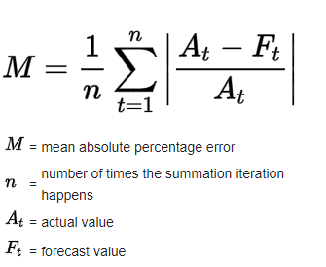
Data and Metrics
2013
2014
2016
2017
2017
2015
Description
Time series product sales data for Favorita stores​
Model Evaluation Metric (MAPE)
Mean absolute percentage error MAPE
15th Aug
31st Aug
Training Dataset
Forecasted Period
Datasets and Variables:
Holiday Events: Date, type, locale, location, description, transferred
Oil: Date, price
Stores: store_nbr, city, state, type, cluster,
Promotions

Slide 5
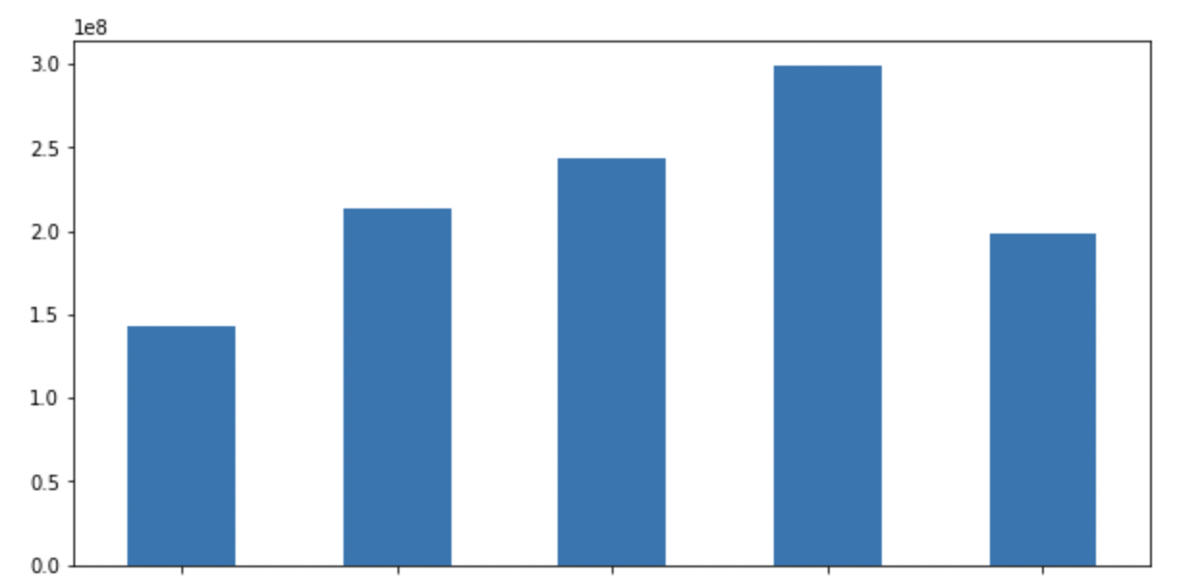
EDA – Overall Sales are increasing every year for Favorita
Top 4 Stores by Sales
Store No. | Sales | City | State
44 | 63.3K | Quito | Pichincha
45 | 55.6K | Quito | Pichincha
47 | 52.0K | Quito | Pichincha
3 | 51.5K | Quito | Pichincha
Sales
Last 5 Stores by Sales
Store No. | Sales | City | State
35 | 7.8 | Playas | Guayas
30 | 7.5 | Guayaquil | Guayas
32 | 6.1 | Guayaquil | Guayas
22 | 4.2 | Puyo | Pastaza
52 | 2.7 | Manta | Manabi
2013
2014
2015
2016
2017
(Till 15th Aug)

Slide 6
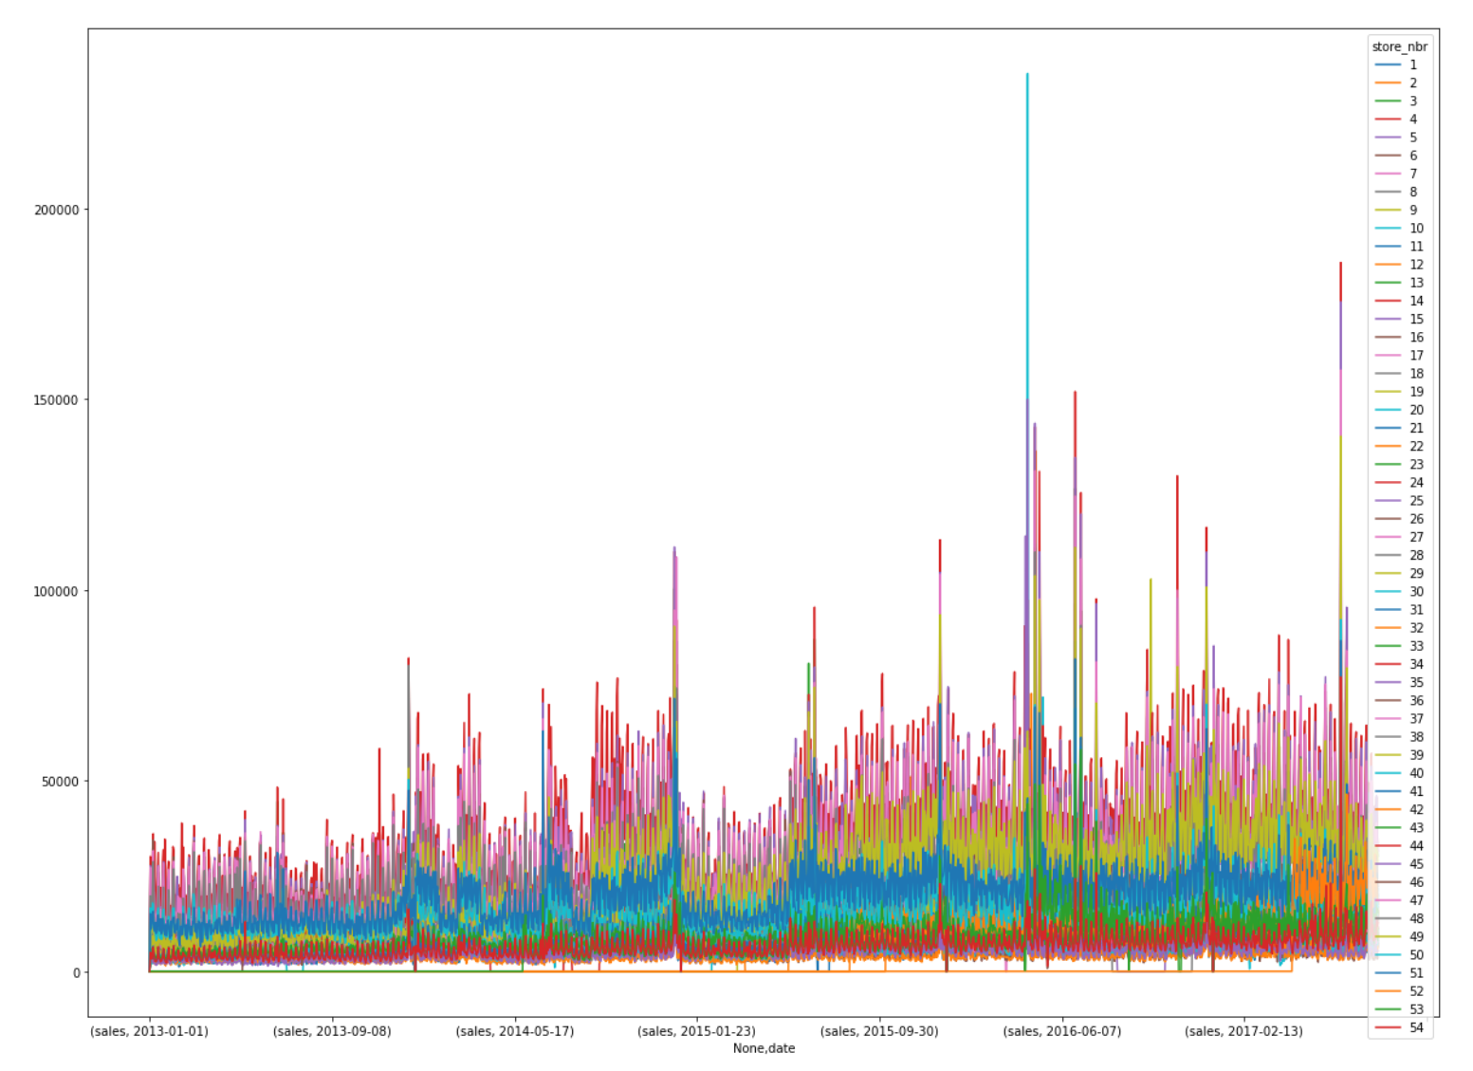
EDA - Time Series for Stores
All stores have the same time series shapes

Slide 7
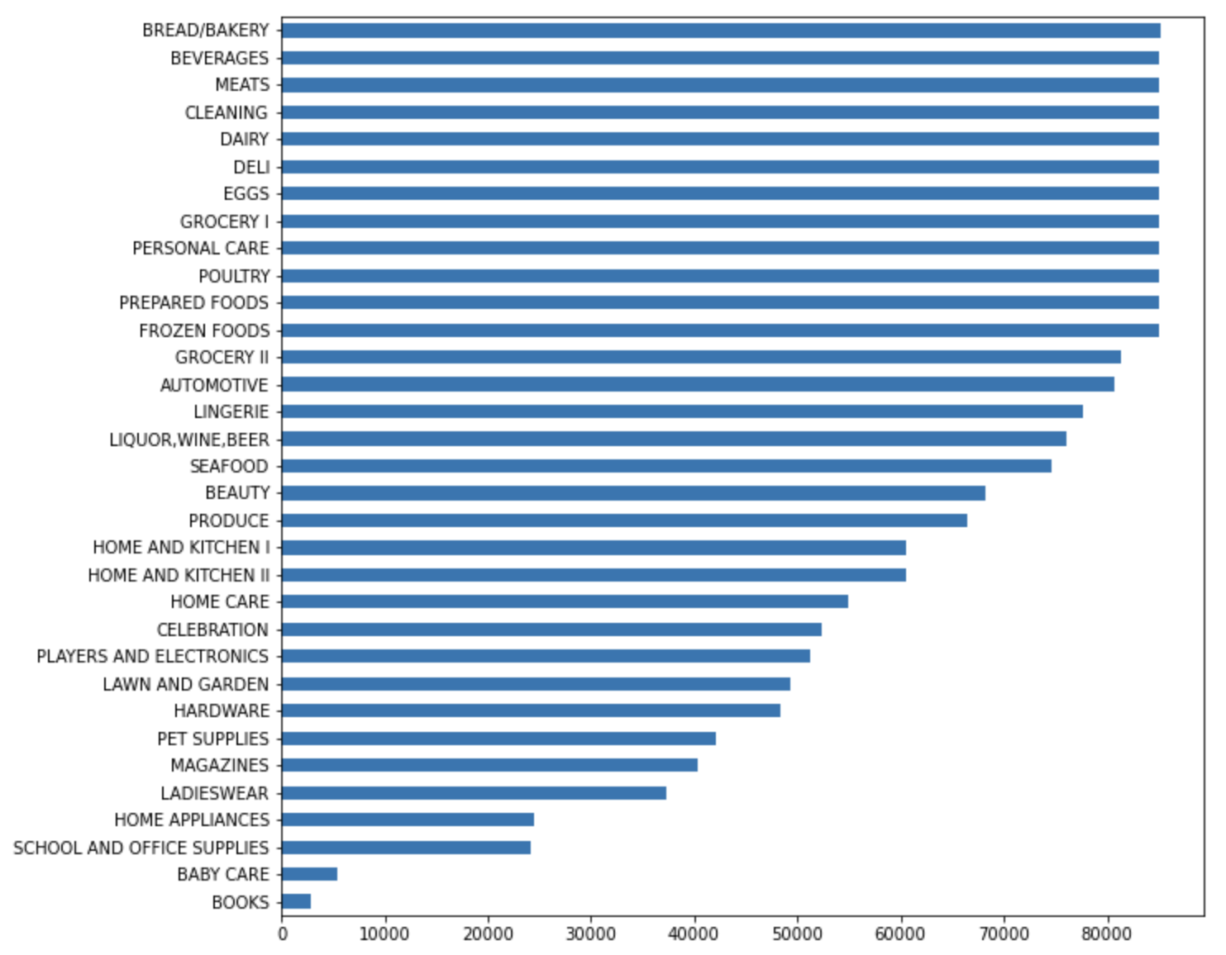
Different Product Types
Everyday Selling
Bread/Bakery, Dairy, Meats etc. which are daily need products
Required but less frequent
Liquor, Kitchen , Home care
Less frequent and Seasonal
Celebration supplies, Hardware, School & Office supplies
Rare Selling
Baby Care and Books

Slide 8
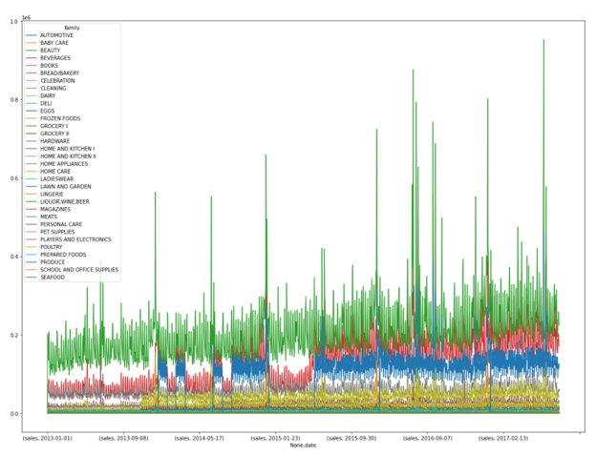
EDA - Time Series for product families
Different product families show variety of time series shapes

Slide 9
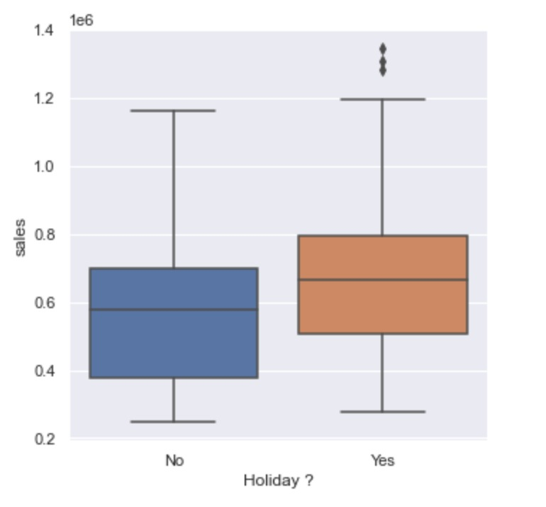
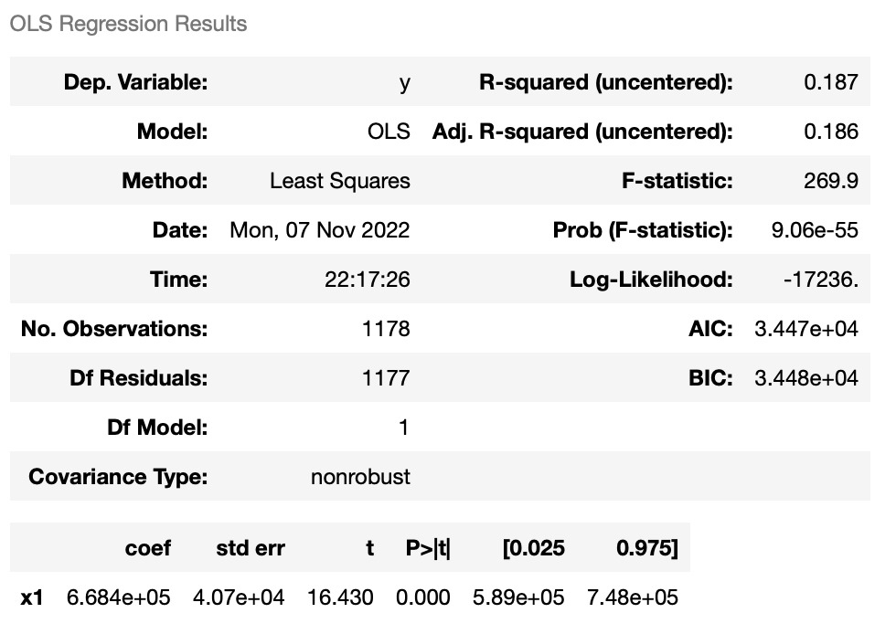



Impact of external factors on sales -
Holidays
Holidays have a positive impact on sales.
The sales go up by 668K at an overall level if it is a holiday given all else constant

Slide 10
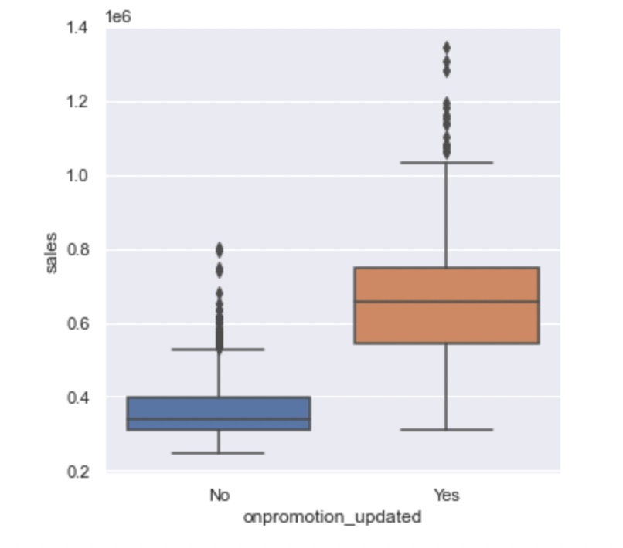
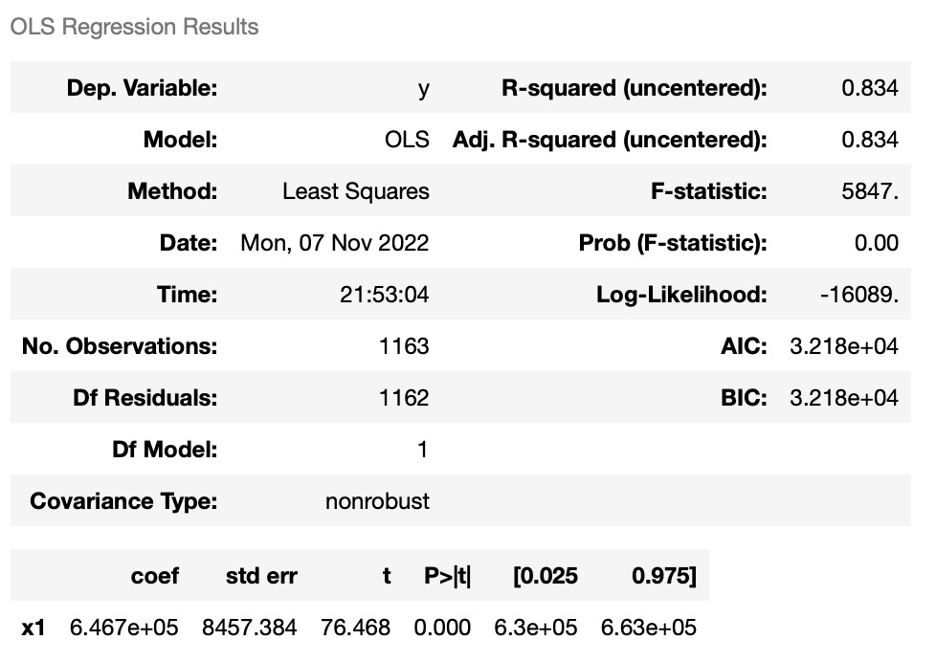


Impact of external factors on sales -
Promotions
Promotions have a positive impact on sales
The sales go up by 647K at an overall level if it is a promotion day given all else constant

Slide 11
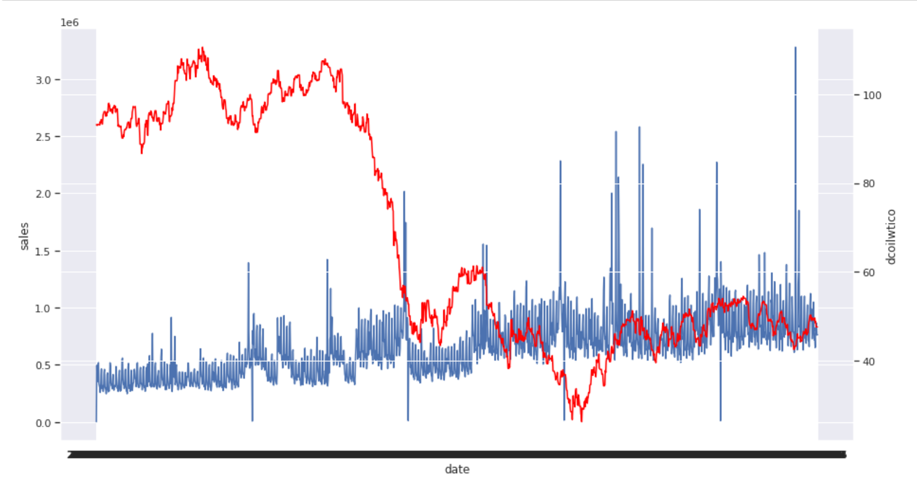
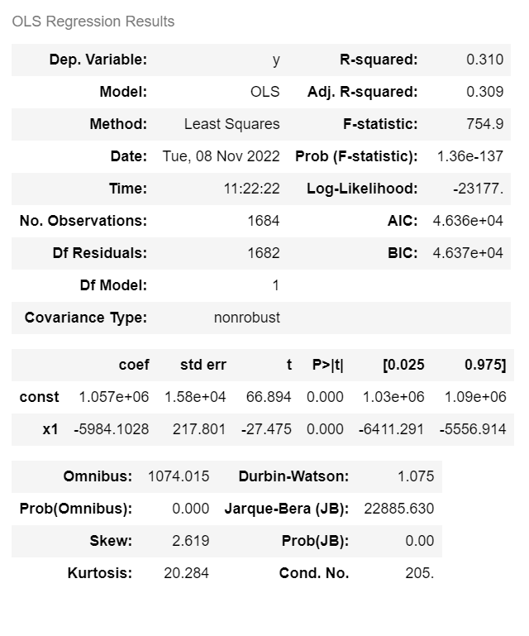
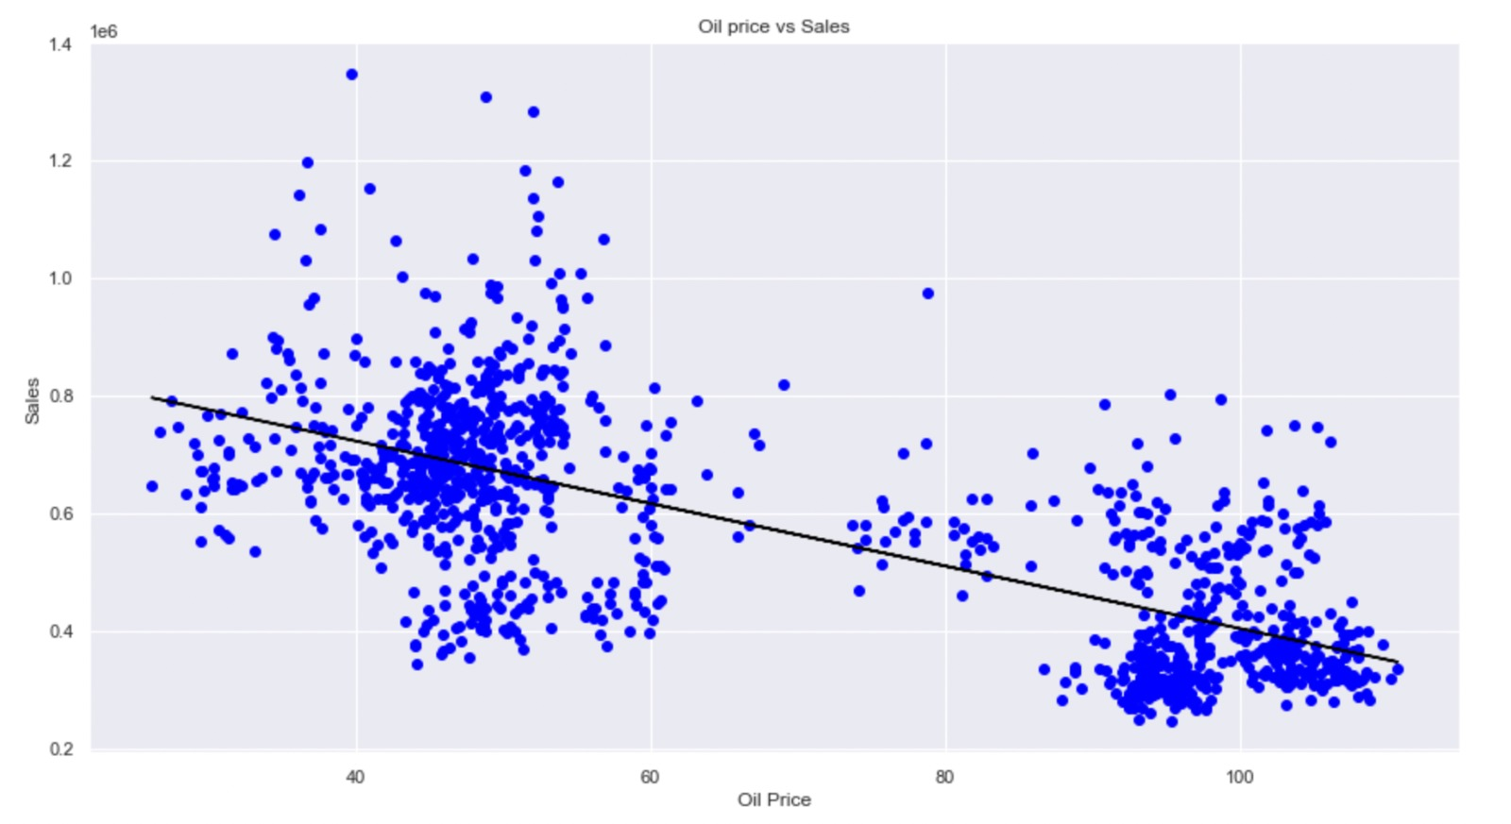
Impact of external factors on sales -
Oil
Change in oil prices and sales
Oil Prices vs. Sales – line fit
There is a strong negative correlation between sales and oil prices

Slide 12
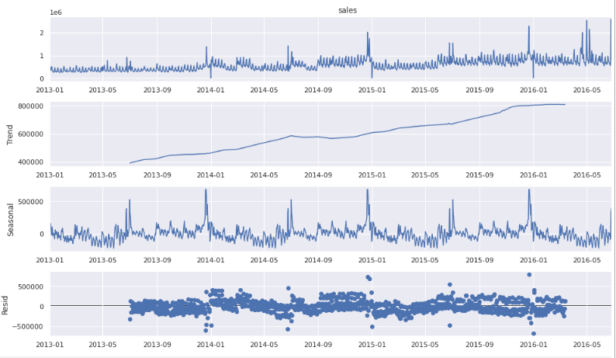
Time Series Decomposition
Original Time series
General Trend
Seasonality​
Residuals

Slide 13
Results for different iterations
Method | MAPE
Simple Exp smoothing | 37%
Rolling exponential smoothing | 37%
Holts (double exp smoothing) | 46.14%
Holts (double exp smoothing) - rolling | 35.17%
Holts Winter (triple exp smoothing) | 48.45%
Holts Winter (triple exp smoothing) - rolling | 45.99%
Propagate trend and seasonality | 35.09%
Propagate trend and seasonality and adjust residue | 35.08%
Rolling point forecasts have better accuracy compared to longer forecasts
Trend and seasonality propagation with adjusted residue have the best results
Double exponential smoothing results are comparable to propagating trend and seasonality

Slide 14
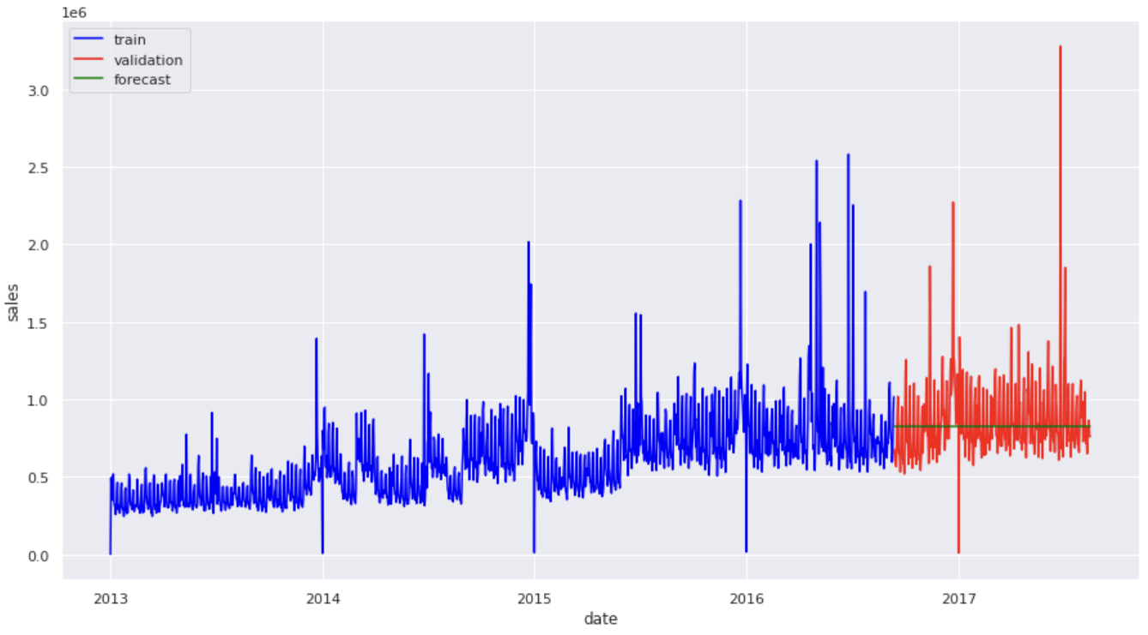


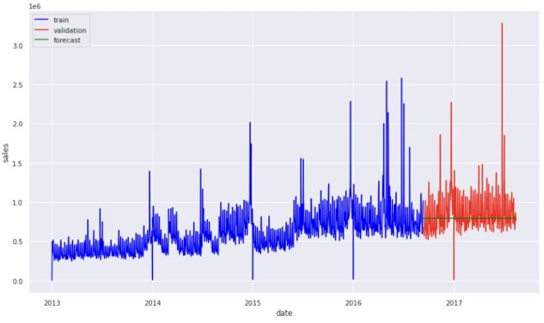
Forecast visuals - (Simple Exponential Smoothing and Holts)
Simple Exponential Smoothing
Simple Exponential Smoothing - Rolling
Holts - (Double Exp Smoothing)
Holts - Rolling

Slide 15
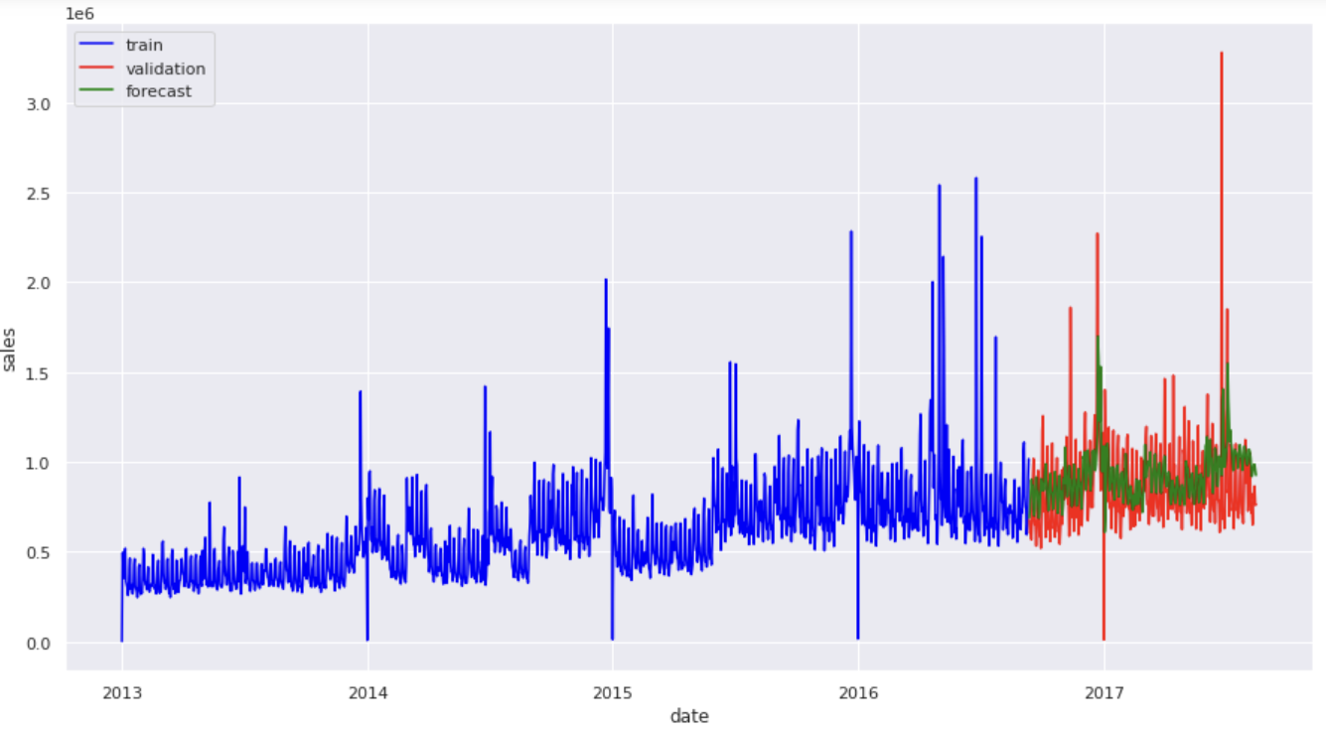

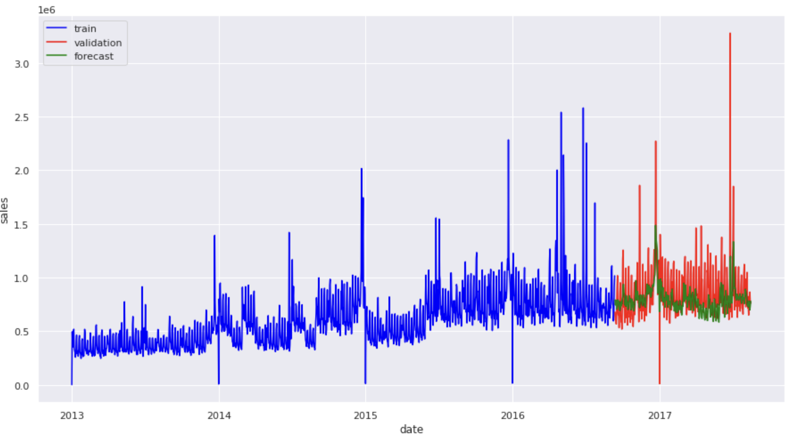

Forecast visuals
Triple Exp Smoothing
Tripe Exp Smoothing - Rolling
Trend and Seasonality prop.
Trend and Seasonality prop. - adj residue

Slide 16
Recommendations
Using this forecast data, Favorita stores can plan inventory for the coming months
It is also important to track the oil prices as they heavily influence sales
The surge in sales during holidays and promotions can also be planned since we included the adjustment for these external regressors in the model
At a store level - Favorita should focus on store 3, 44, 45, 47 and 49
Next Steps
Going forward... use store and product level forecasts at a daily level with adjustment for external regressors to determine inventory planning at a store level

Slide 17
Thank You

Slide 18
Appendix

Slide 19
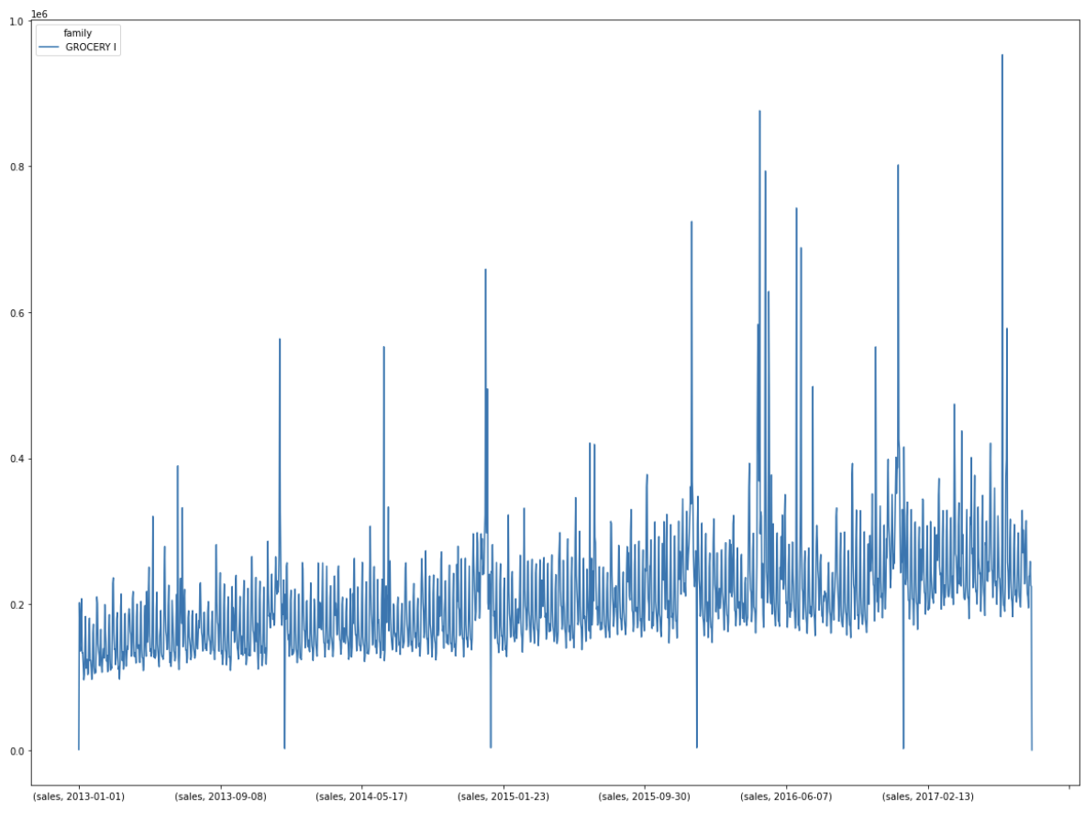
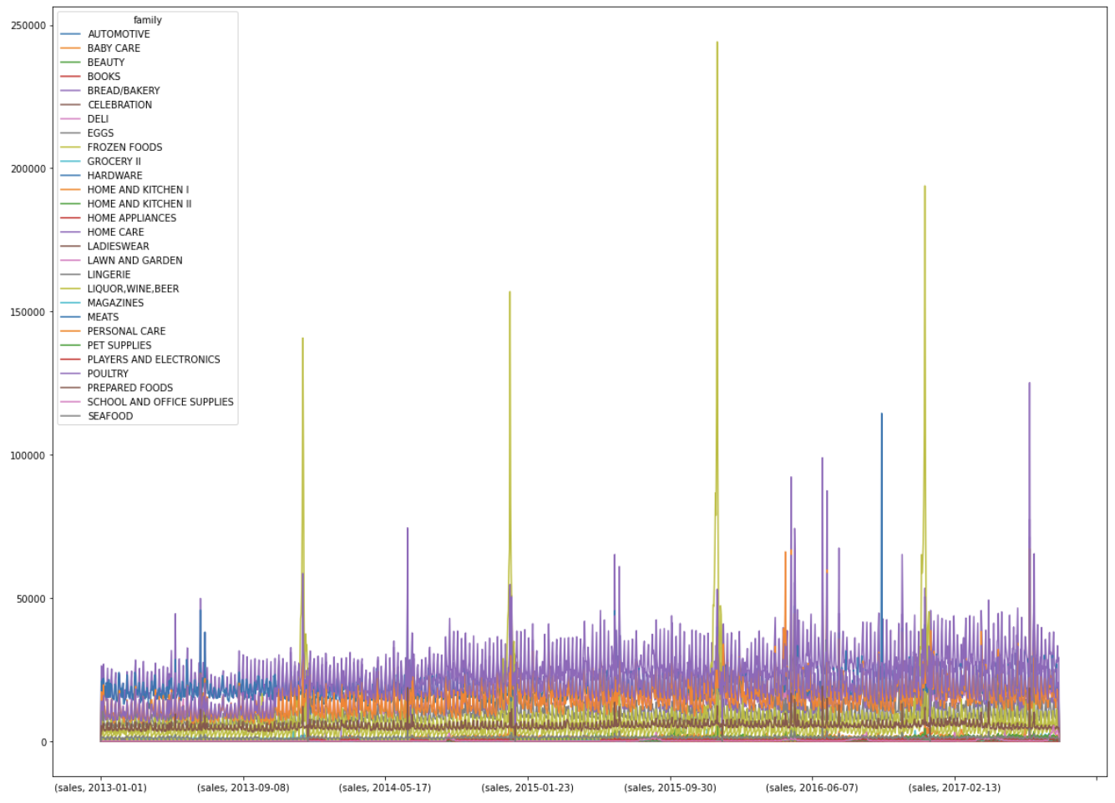
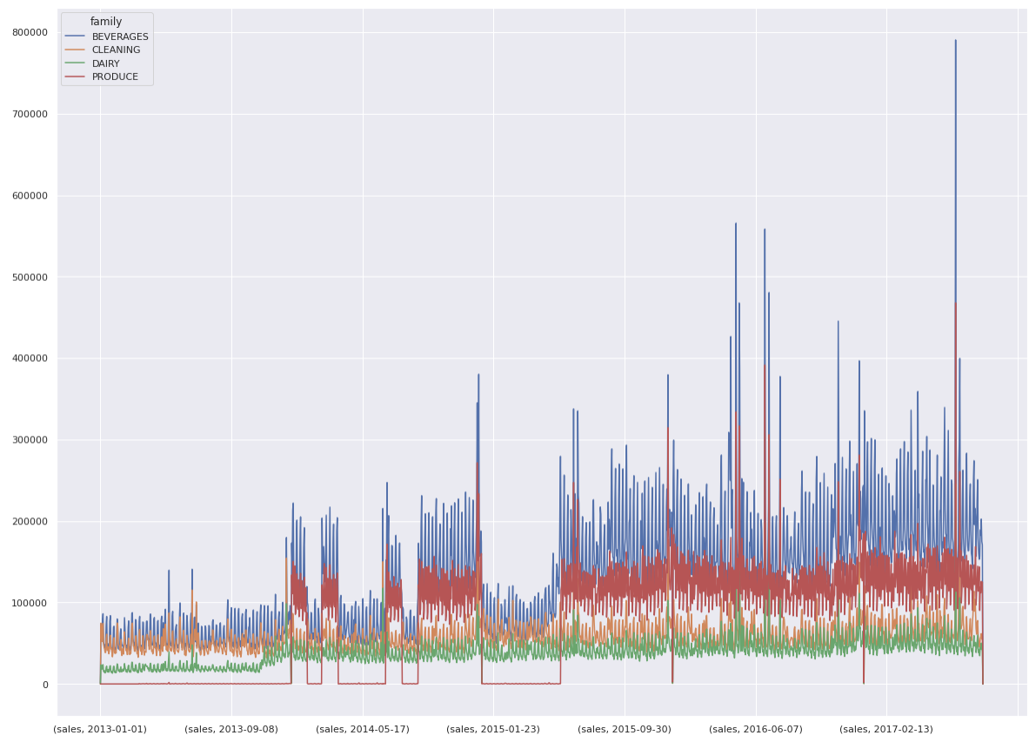
Time series shape clustering –

